Slide 1
CSE440: Natural Language Processing II
Farig Sadeque
Assistant Professor
Department of Computer Science and Engineering
BRAC University

Slide 2
Lecture 6: Neural Nets and RNN

Slide 3
Outline
Neural Networks (SLP 7 and lecture)
Recurrent neural networks (SLP 9 and lecture)

Slide 4
Before starting learning sequence ….
We need to remember some neural network basics.

Slide 5
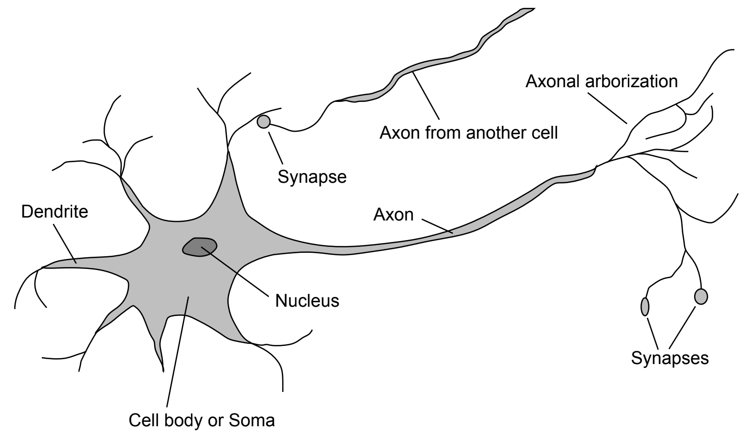
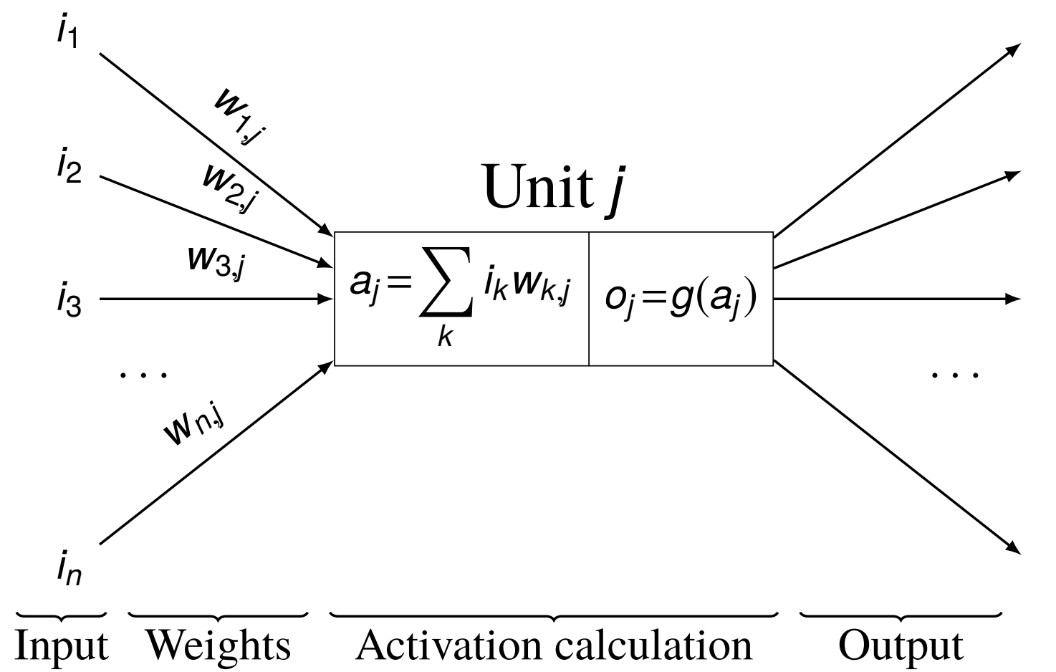
Neural Networks
Neuron in a human brain
Neuron in an ML model

Slide 6
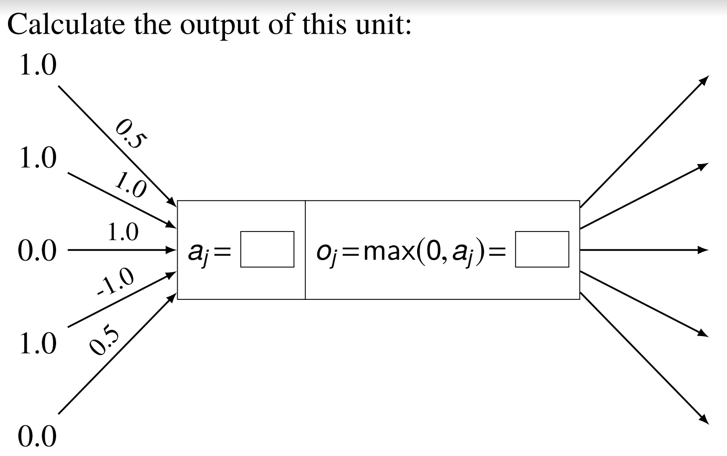
Class work

Slide 7
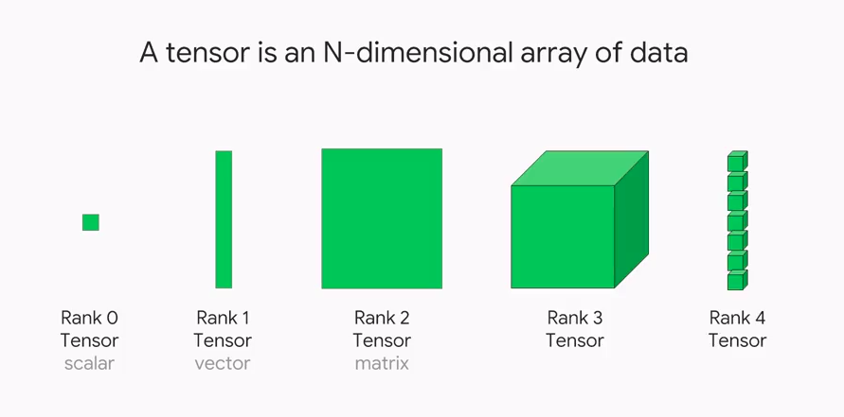
Unit calculations as tensor arithmetic
What is a tensor?

Slide 8
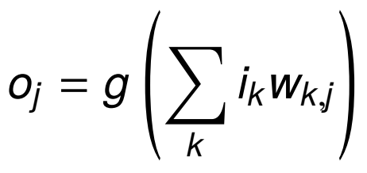
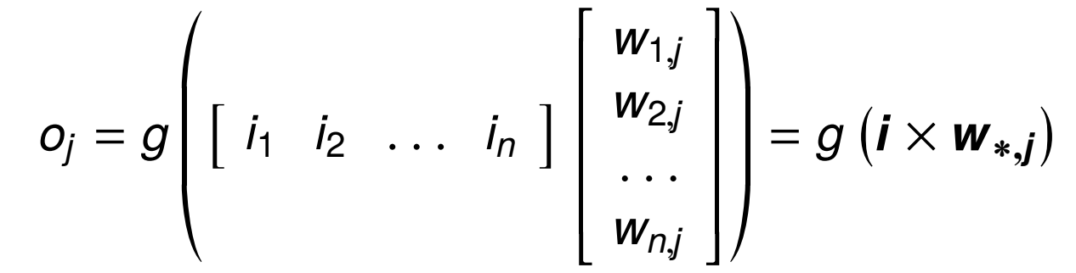
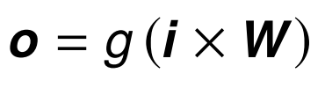
Unit calculations as tensor arithmetic
Summation for a single unit:
Vector arithmetic for a single unit:
Matrix arithmetic for multiple units:

Slide 9
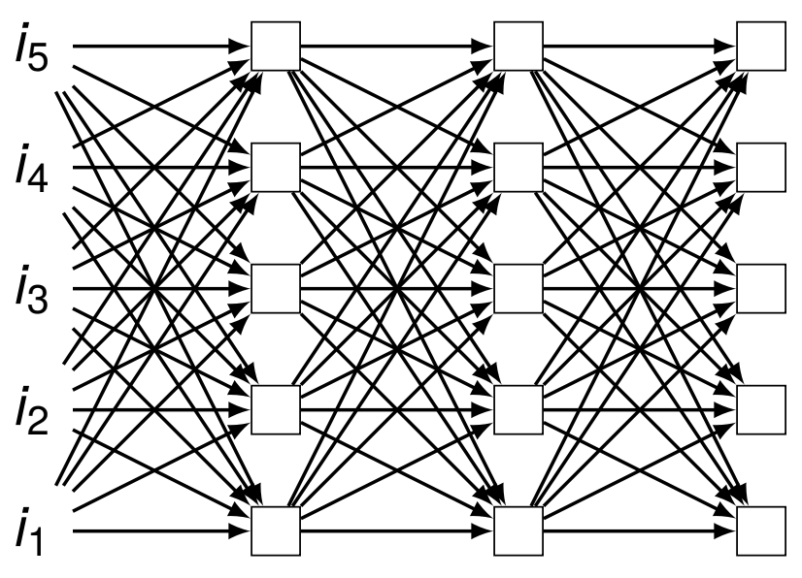
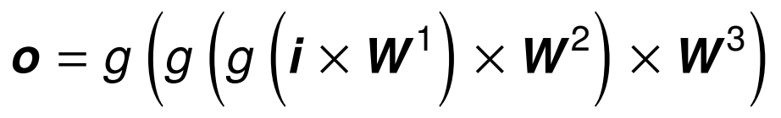
A feedforward network as composition

Slide 10
Activation functions
Why do we need activation functions?
What types of activation functions do we have?

Slide 11
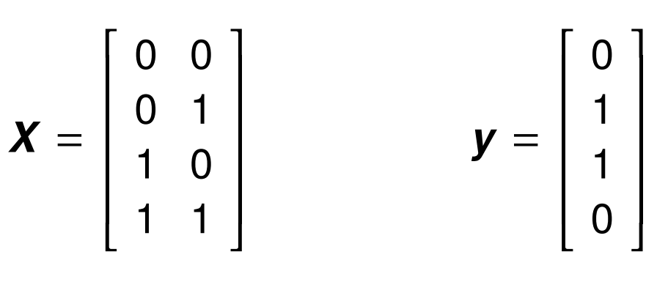

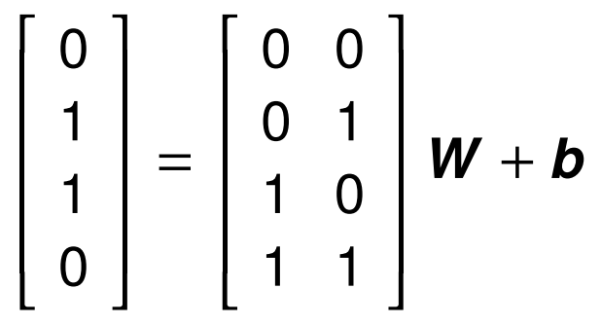
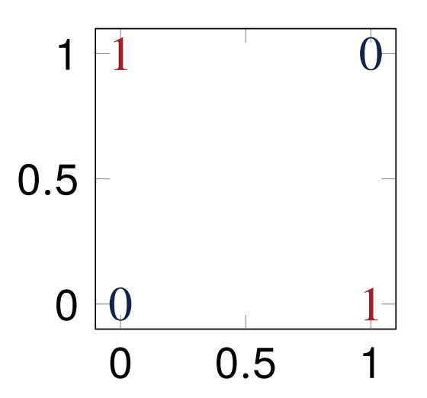
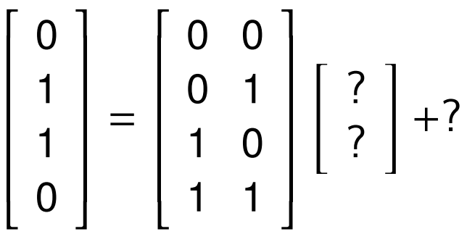
Learning the XOR
Can you solve it with linear regression?
No such weights exist!

Slide 12
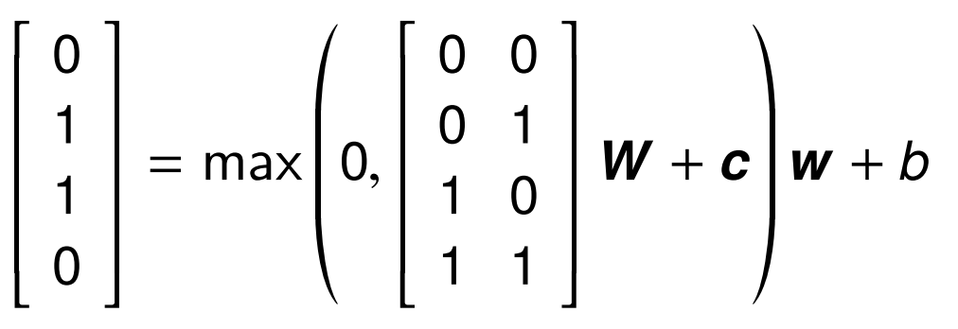
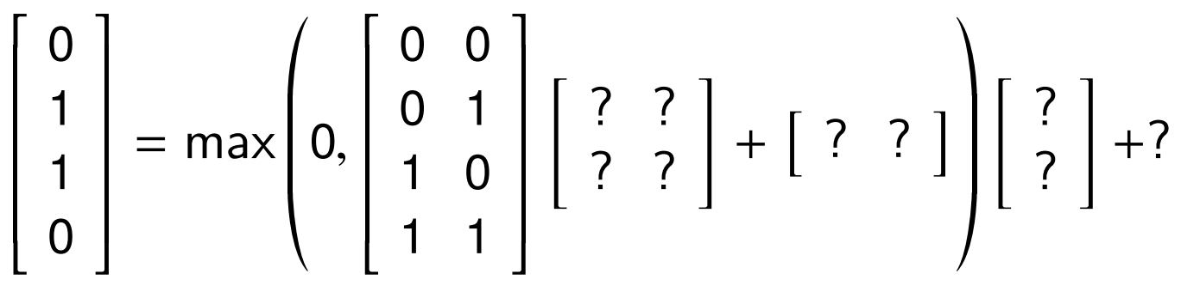
Solving XOR with NNs

Slide 13
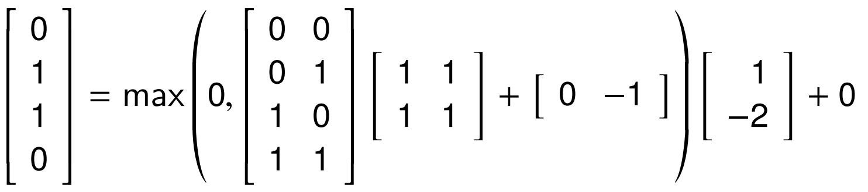
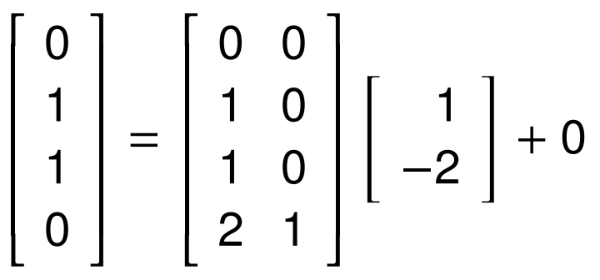
Solving XOR with NNs

Slide 14

Common activation functions in hidden units
We have: affine transformation of input x, followed by nonlinear activation function
g could be just about anything! It can be linear, but a linear function is not preferred. Why?
Considerations:
What specific behavior is needed?
How will the gradients behave?

Slide 15
Why linear functions are not preferred?
Because of the considerations.
We need complex mappings between the inputs and the outputs
All linear layers will translate the input linearly to output– that is, multiple linear transformation is basically one giant linear transformation
Cannot use backpropagation as the derivative is constant

Slide 16
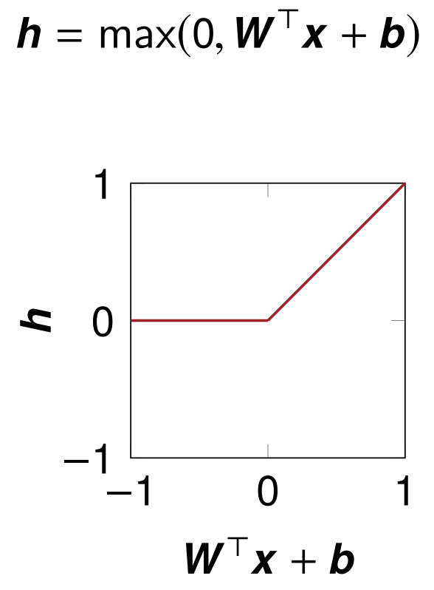
ReLU
Behavior?
Active only when input is positive
Gradients?
1 when positive
0 when negative

Slide 17
ReLU is non-differentiable
ReLU at z = 0:
left derivative = 0
right derivative = 1
So ReLU is not differentiable at z = 0!
A few non-differentiable points are not a problem:
Training rarely reaches a point with gradient 0 anyway
Software simply returns either left or right derivative

Slide 18
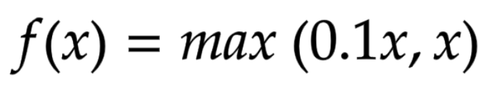
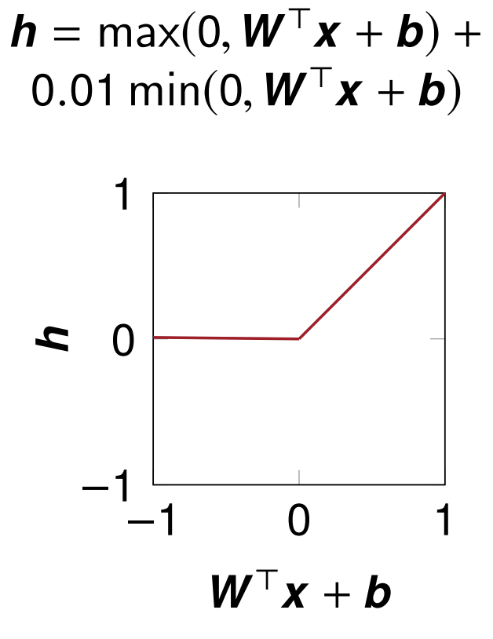
Leaky ReLU
ReLU has a “dead neuron” problem!
Behavior?
Strong positive activation when positive
Very weak negative activation when negative
Gradients?
1 when positive
0.1 when negative

Slide 19
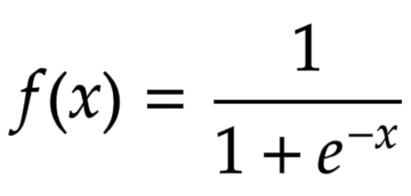
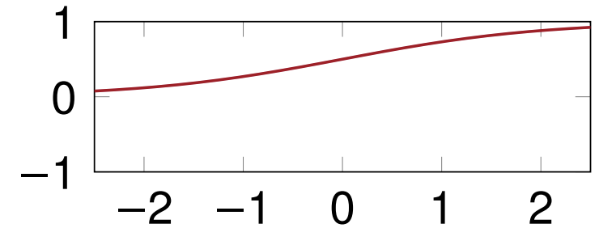
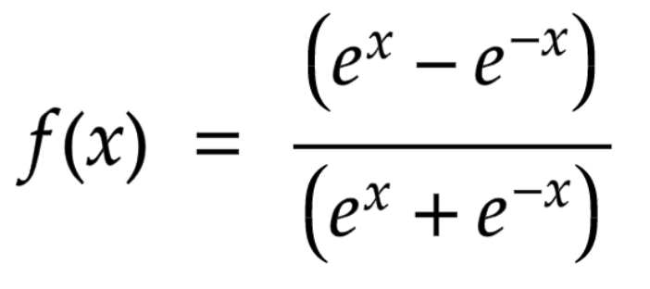
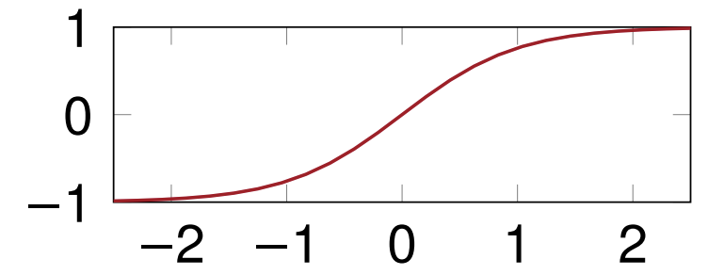
Sigmoid and tanh
Sigmoid:
Tanh:
Behavior?
Sigmoid: 0/1 switch
Tanh: -1/+1 switch
Gradients?
Saturate across most of their domain
Tanh optimizes slightly better since it is similar to the identity function near 0

Slide 20
Hyperparameters
Network parameters are the ones that are being learned throughout the training process (e.g. weights)
There are parameters that we can control to facilitate this learning: they are called hyperparameters
Activation function is one such hyperparameter
We have others …

Slide 21
Optimizers
Algorithms used to update the learnable parameters in order to reduce loss
Common optimizers:
Gradient descent
Stochastic gradient descent
Mini-batch gradient descent
Momentum
Adagrad
RMSProp
AdaDelta
Adaptive moment estimation
GD methods maintain a single learning rate (with/without decay for all parameters and are known as first order optimizers (works with the first order derivative)
Adaptive methods like Adagrad provide learning rates for each parameter, thus improving the learnability, but are computationally expensive
RMSProp not only provides LR for each parameter, it adapts based on the mean of recent magnitudes of the gradients for the weight → first order. AdaDelta is similar but works with squared gradients (second order)

Slide 22
Adaptive moment estimation
Popularly known as Adam (not ADAM)
Came out of OpenAI and University of Toronto
Most likely the highest cited paper in recent history
Why is it so popular?
Straightforward to implement
Little memory requirements
Well suited for problems that are large in terms of data and/or parameters
Needs little to no manual tuning

Slide 23
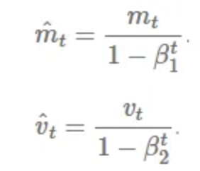
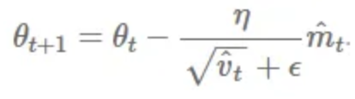
Adam
Adam works with momentums of first and second order
Instead of adapting the parameter learning rates based on the average first moment (the mean), m_{t} as in RMSProp, Adam also makes use of the average of the second moments of the gradients (the uncentered variance) v_{t}
The values for β1 is 0.9 , 0.999 for β2 and epsilon is an extremely small number to avoid zero division

Slide 24
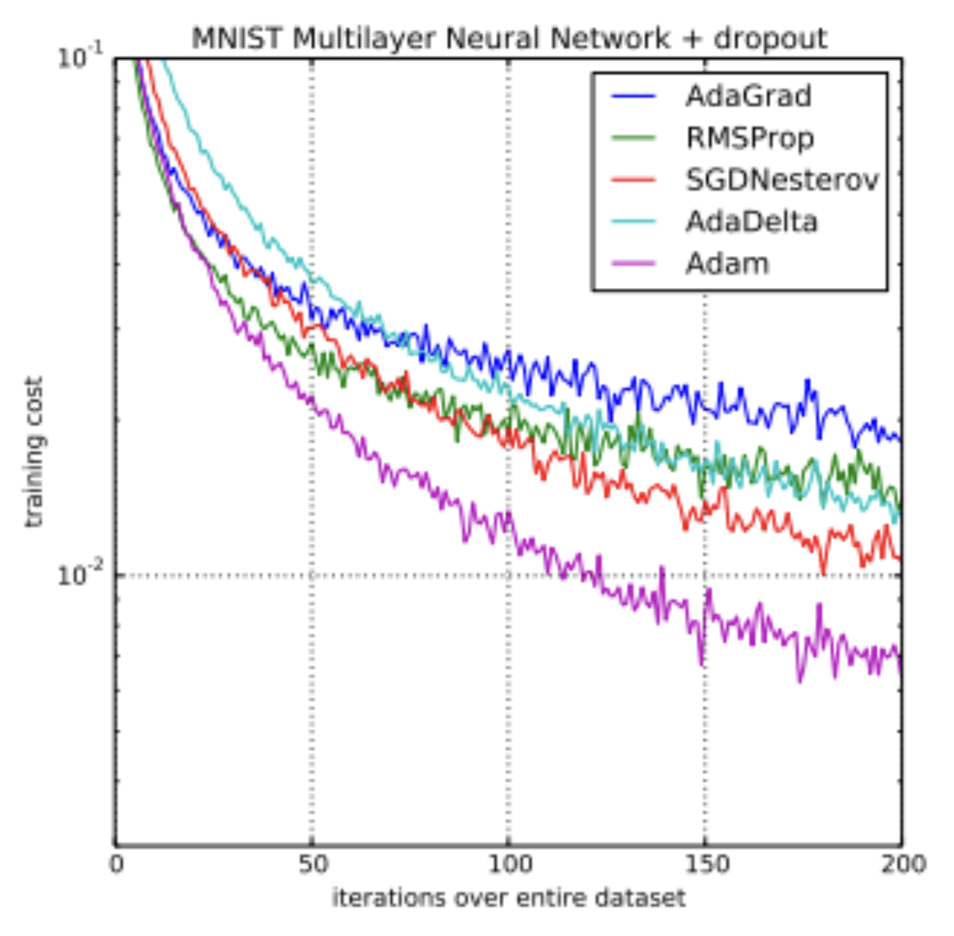
Adam’s popularity
Sebastian Ruder: “... RMSprop, Adadelta, and Adam are very similar algorithms that do well in similar circumstances. ….. Adam might be the best overall choice.”
Andrej Karpathy: “In practice Adam is currently recommended as the default algorithm to use, and often works slightly better than RMSProp.”

Slide 25
Regularization
A set of strategies used in Machine Learning to reduce the generalization error
Why?
Bias-variance tradeoff
Bias: error from wrong assumptions in the learning algorithm
High bias can cause an algorithm to miss the relevant relations between features and target outputs → Observations don’t matter
Underfitting
Variance: error from sensitivity to small fluctuations in the training set
High variance may result in modeling the random noise in the training data → focusing too much on observations
Overfitting

Slide 26
Regularization
A good model needs to balance bias and variance
Regularization helps us do that

Slide 27
Regularization techniques
Introduce regularization term to the loss function
Introduces a small amount of bias to counter variance → reduce overfitting
Loss function: negative log likelihood or binary cross entropy
Most common terms:
L2 regularizer: Ridge regression → adds the “squared magnitude” of the coefficient as the penalty term to the loss function
L1 regularizer: Lasso regression → adds the “absolute value of magnitude” of the coefficient as a penalty term to the loss function
Uses 𝛌 that controls the sensitivity of`the model to the input → less sensitive, less likely to overfit
L2 focuses on larger weights, so higher 𝛌 means L2 penalizes higher value weights more than lower ones → no feature essentially goes away
L1 has equal focus, so, higher 𝛌 → low weight features go away → feature selection

Slide 28
Regularization techniques
Dropout: Drops out (ignore) a layer’s output with a probability p
Choice of p depends on the architecture
Early stopping: Stops when performance gets saturated
Stops model from being overfit
Returns the best current model
Data augmentation
Introduce new training data with variation
Injects noise

Slide 29
Other common hyperparameters
Learning rate: how quickly a network updates its parameters
Low learning rate slows down the learning process but converges smoothly
Larger learning rate speeds up the learning but may not converge
Decaying learning rate is preferred
Epochs: How many times the entire training dataset has passed through the model
Batch size: (Mini) batch size refers to a subset of the training data. Weights are updated after each mini batch training
Small mini batch → too many updates
Large mini batch → too few updates, too many epochs to converge

Slide 30
Recurrent Neural Networks (RNN)
Simple recurrent networks
Bidirectional and gated recurrent networks
Recurrent architectures
Seq2Seq models
Attention

Slide 31
Short history of RNN
1986: RNNs are Introduced by David Rumelhart
1995: LSTMs are introduced by Sepp Hochreiter and Jürgen Schmidhuber based on Hochreiter’s 1991 research on vanishing gradient problem
2001: Gers and Schmidhuber trained LSTMs to learn language models (unlearnable by HMMs)
2009: Graves et al. won ICDAR handwriting recognition competition using LSTMs
2013: Hinton and his team destroyed previous record for speech recognition using LSTM
2014: GRU is introduced by Cho et al.
2015: Widespread use in both academia and industry due to Google’s adaptation of LSTM in their Google Voice speech recognition system

Slide 32
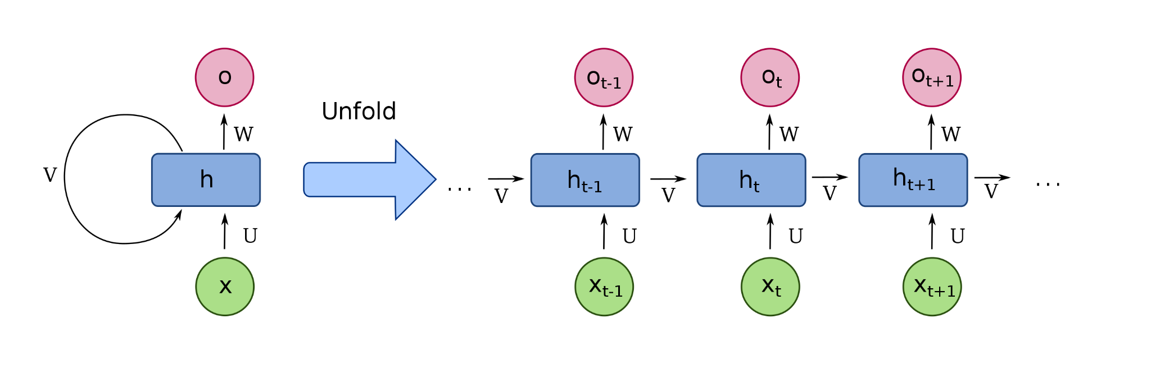
Structure of an RNN

Slide 33
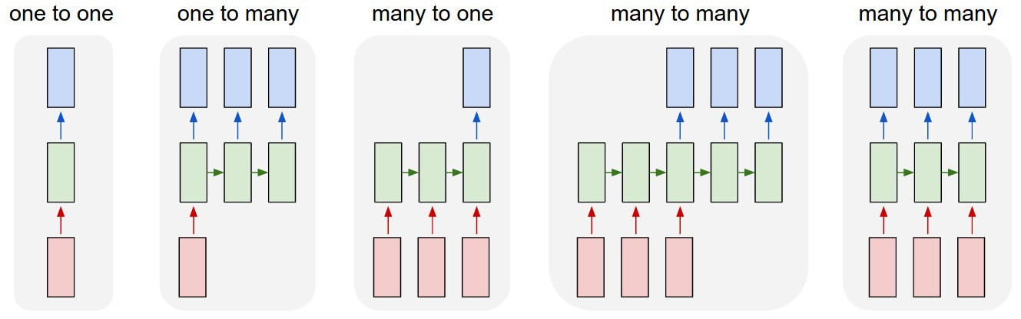
Types of RNNs
https://karpathy.github.io/2015/05/21/rnn-effectiveness/

Slide 34
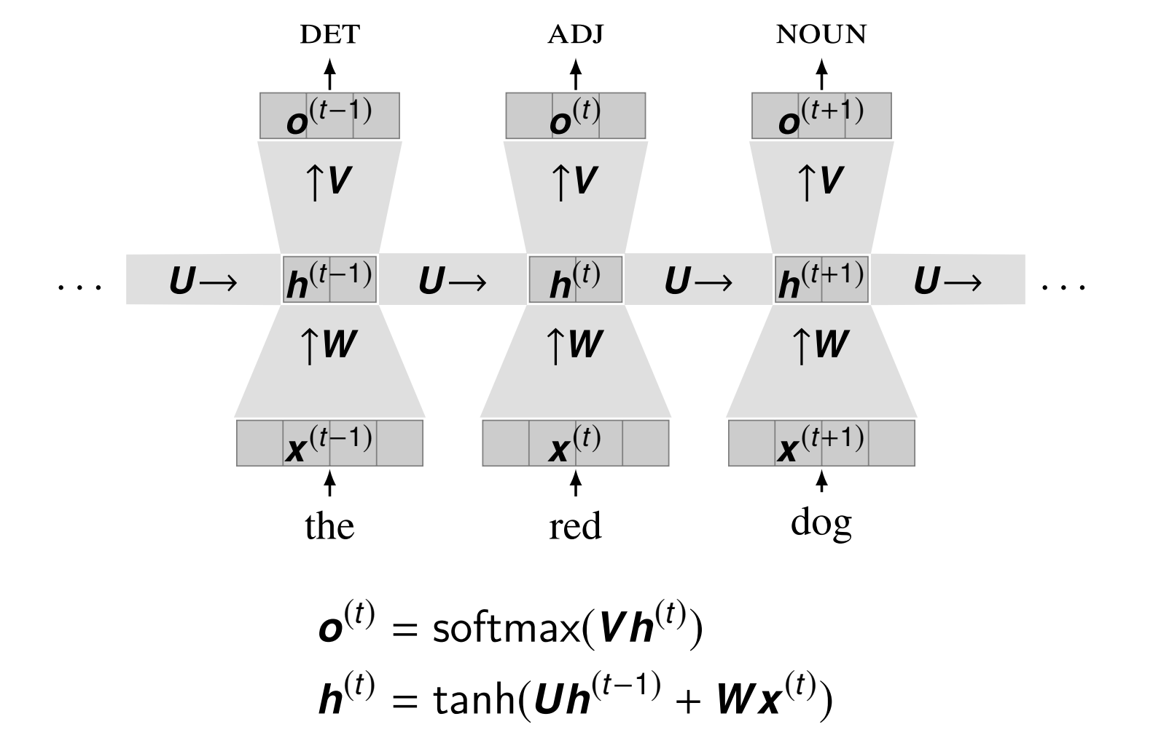
A completely unrolled Simple RNN

Slide 35
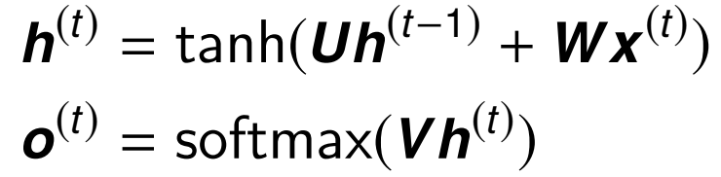
Simple RNN
Intuitions:
Each step combines the current input with the history
Each prediction is made based on this combination
Observations:
The input and hidden state change at each time step
The parameters W, U, V are the same at each step
Equations:

Slide 36
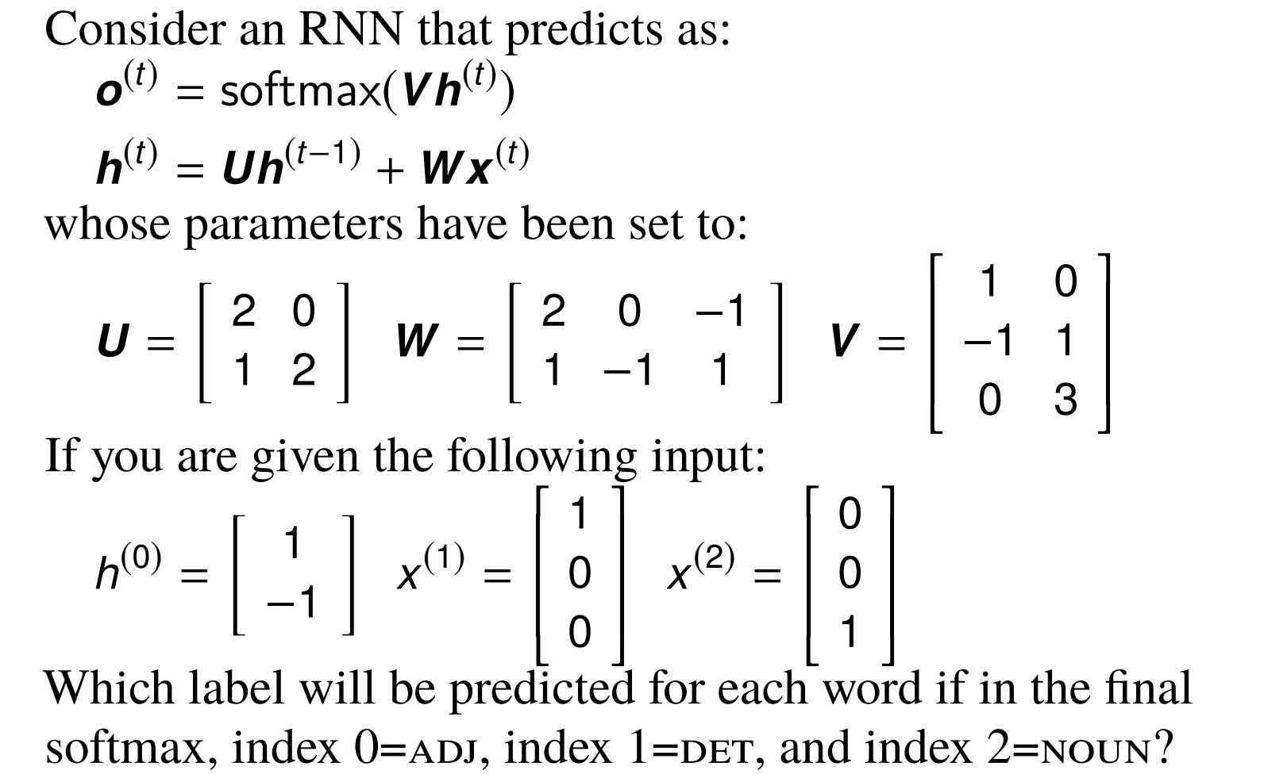
Classwork

Slide 37
Drawbacks of simple RNN
They can only see the past, not the future
They must forget the same amount of history at each time step
Theoretically, they don’t have to
Maintaining long term memory is difficult

Slide 38
Bidirectional RNNs
Intuition:
Run one forward RNN
Run one backward RNN
Combine their outputs

Slide 39
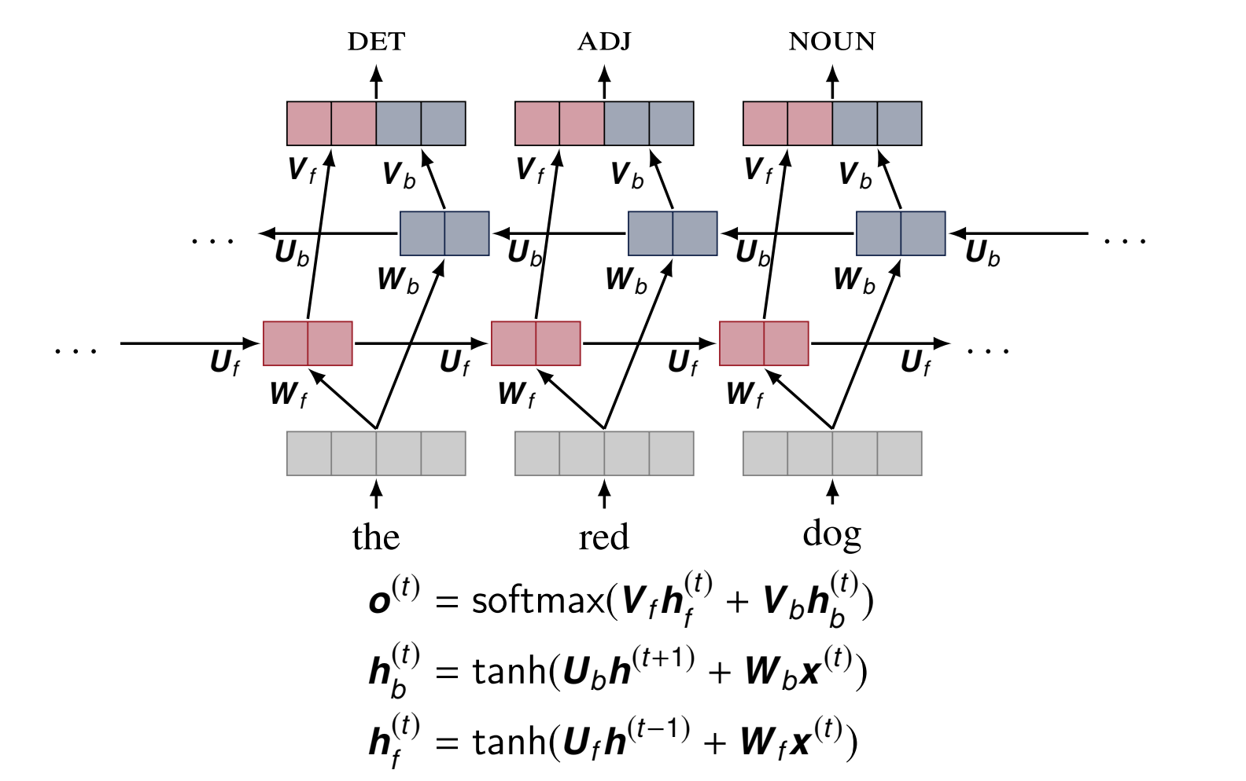
Bidirectional RNNs

Slide 40
Gated RNNs
Intuition:
Simple RNNs forget the same amount at each time step
Look at the previous hidden state and the current input
Decide how much to forget based on those
Two gated RNNs
Long Short-Term Memory (LSTM)
Gated Recurrent Units (GRU)

Slide 41
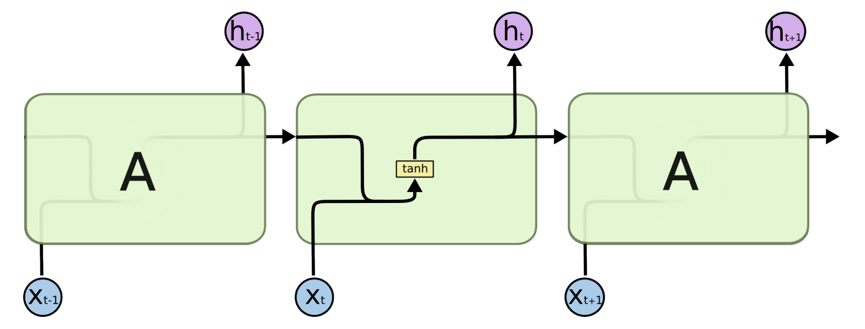
Simple RNN

Slide 42
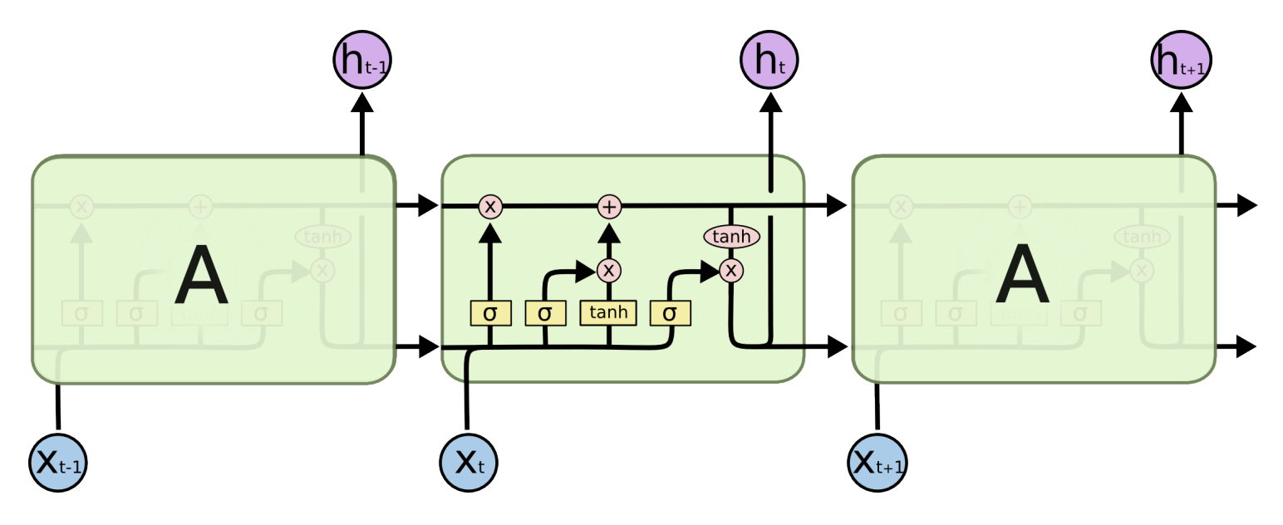
LSTM

Slide 43
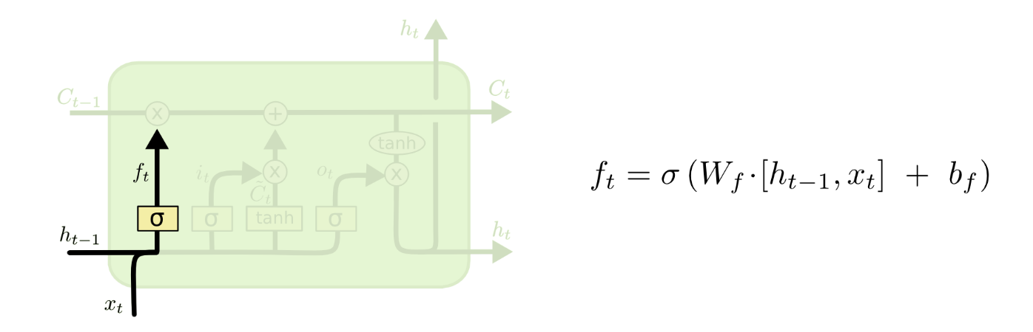
Forget gate

Slide 44
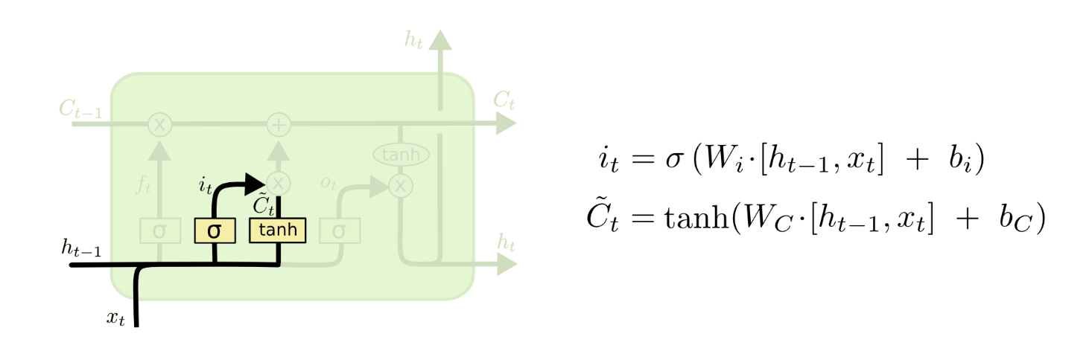
Input gate

Slide 45
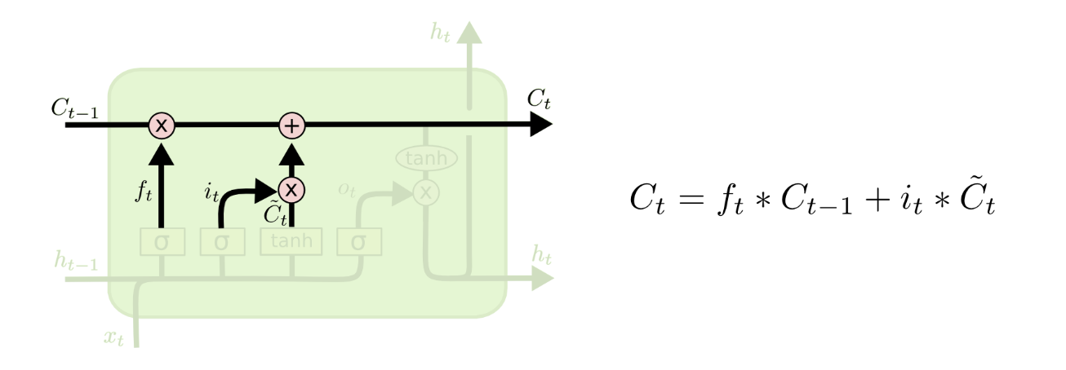
Cell update

Slide 46
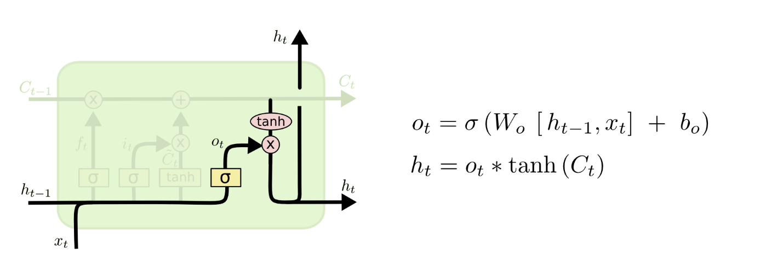
Output gate

Slide 47
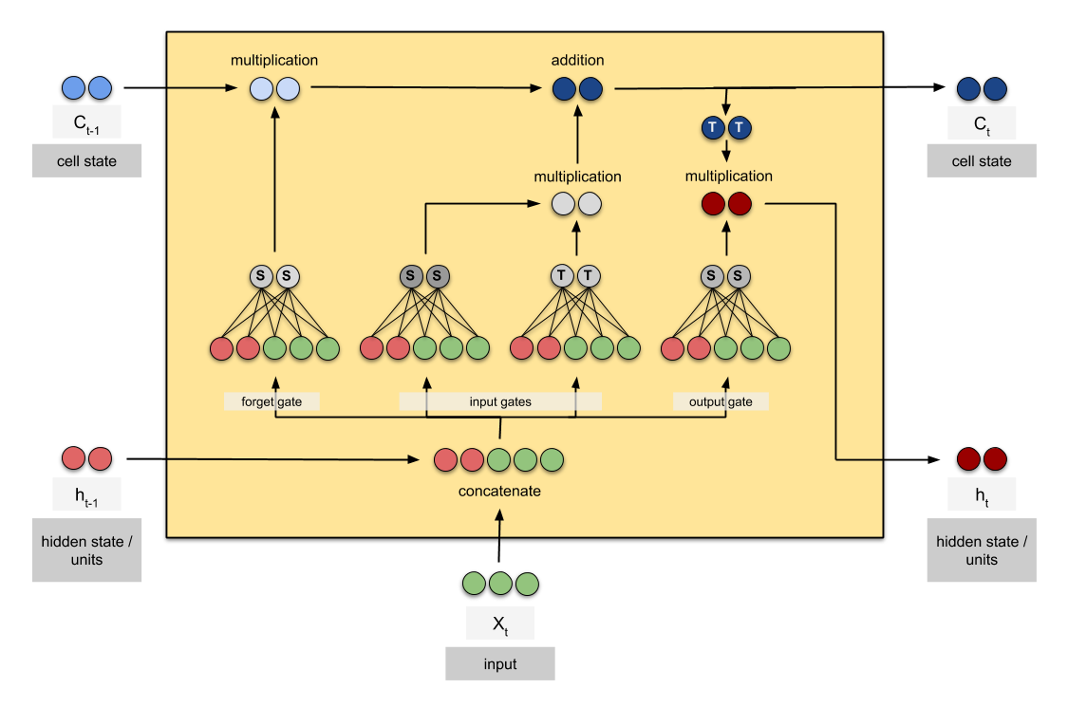
One LSTM cell

Slide 48
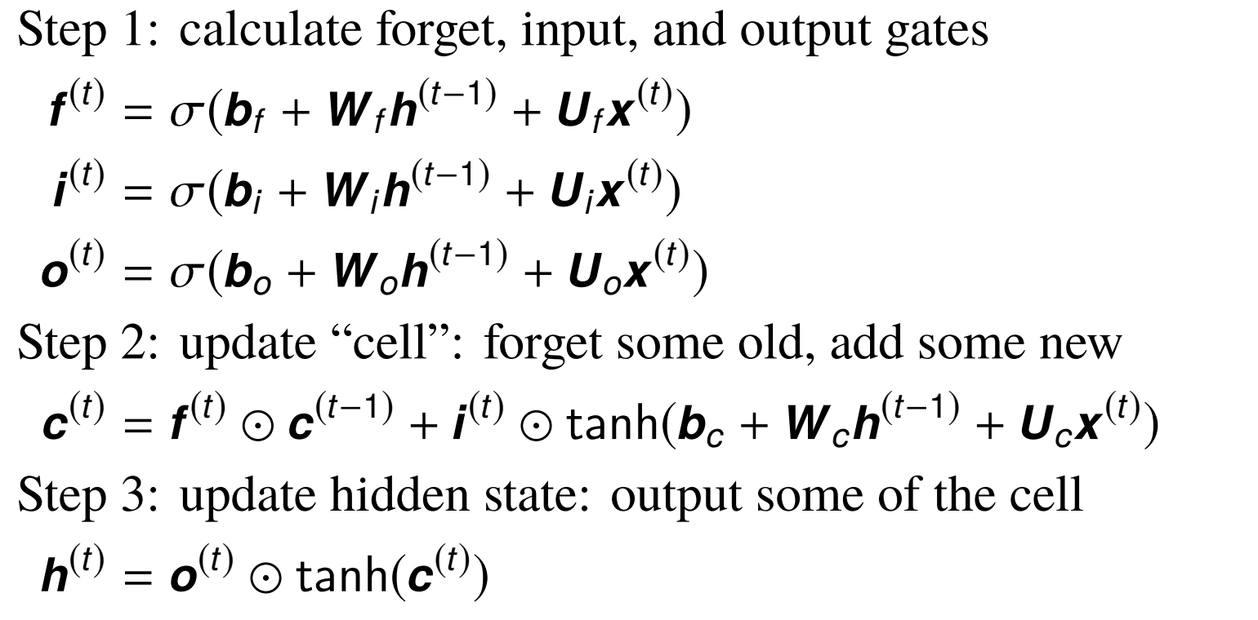
LSTM

Slide 49
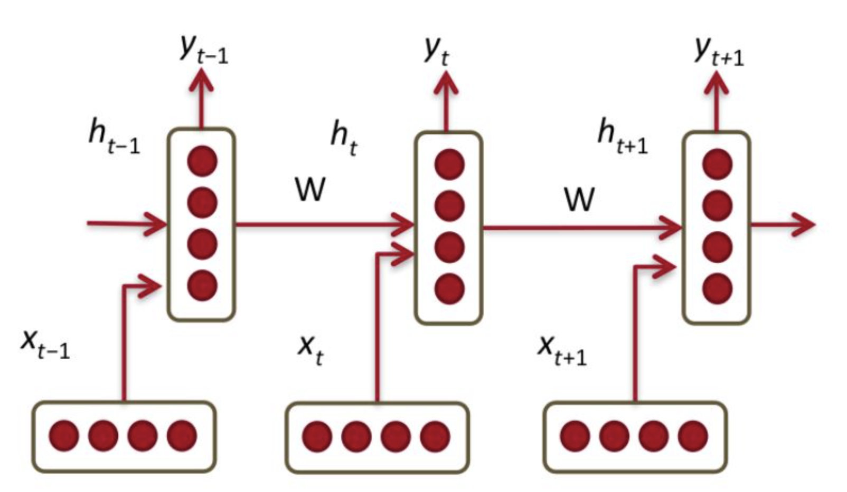
LSTM Network

Slide 50
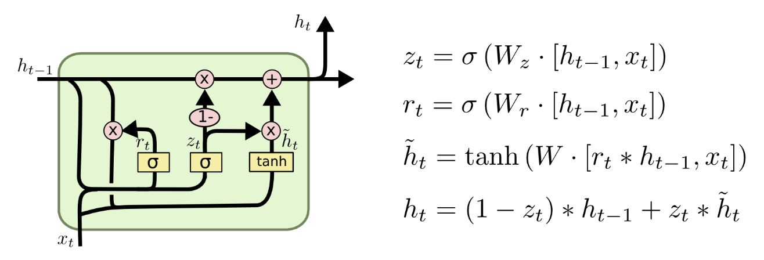
GRU

Slide 51
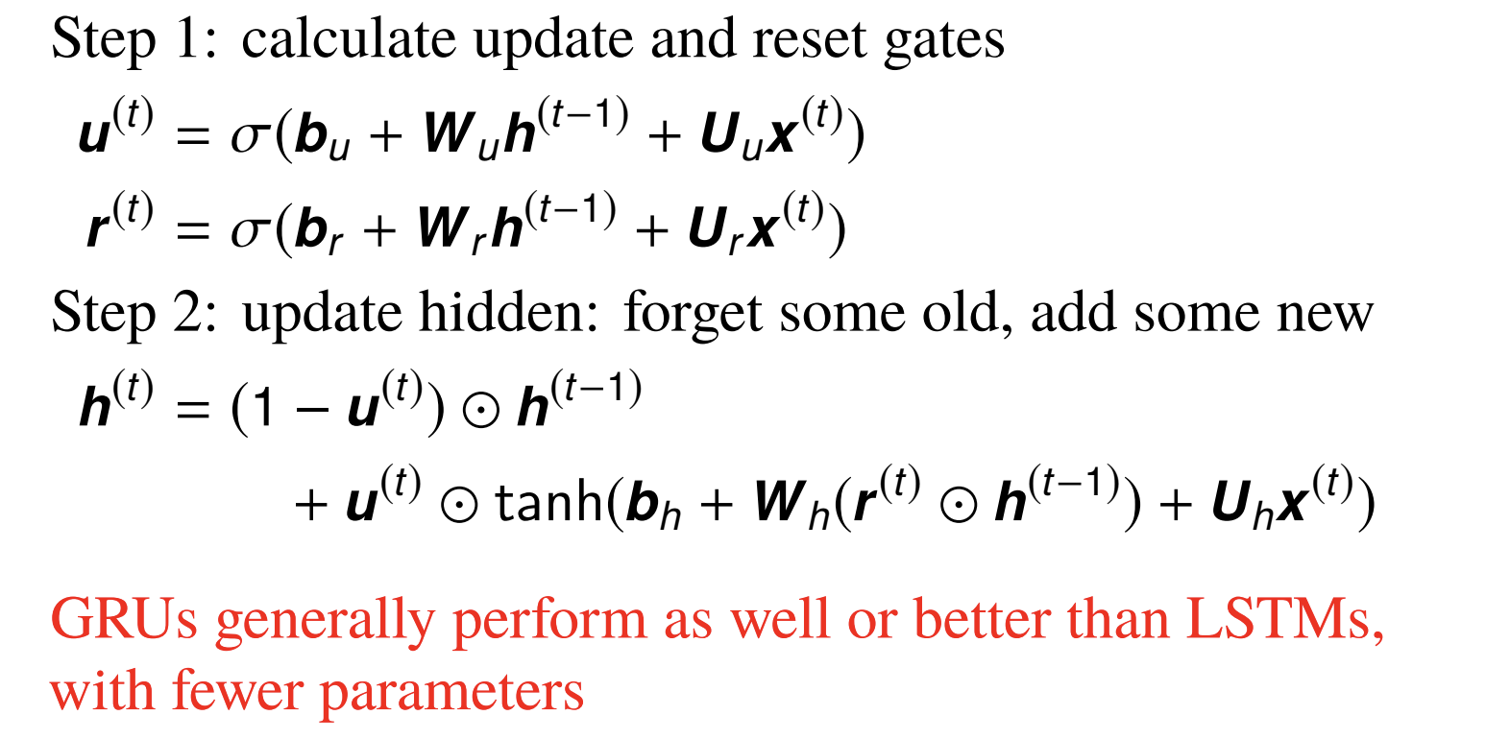
GRU

Slide 52
Gated RNNs
Properties:
Can forget different amounts at each time step
Much better at using long distance information
A bidirectional GRU is a good starting point for many sequence tagging tasks

Slide 53
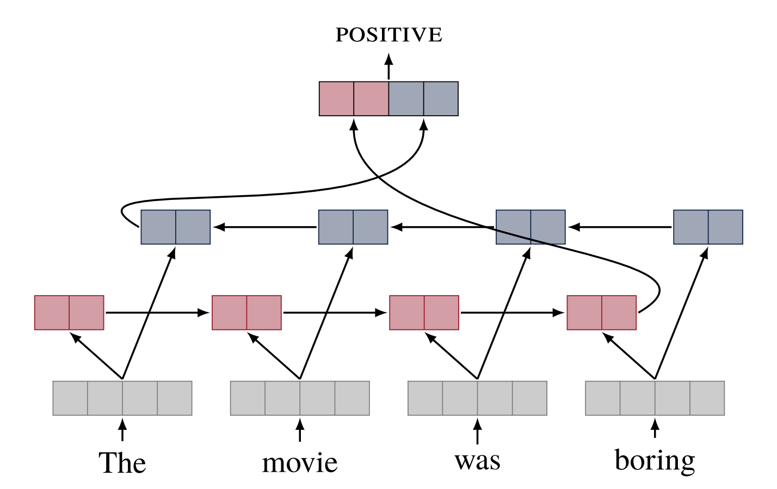
Recurrent architectures for related tasks
RNNs for text classification
Last hidden state of the RNN represents the entire sentence.

Slide 54
Recurrent architectures for related tasks
What other tasks can RNNs handle?

Slide 55
Next to come
Seq2seq models
Encoders and decoders
Attention
Autoregressive models
Transformers
A whole lotta variations
Transformer-encoders vs. transformer-decoders

